Slide 1
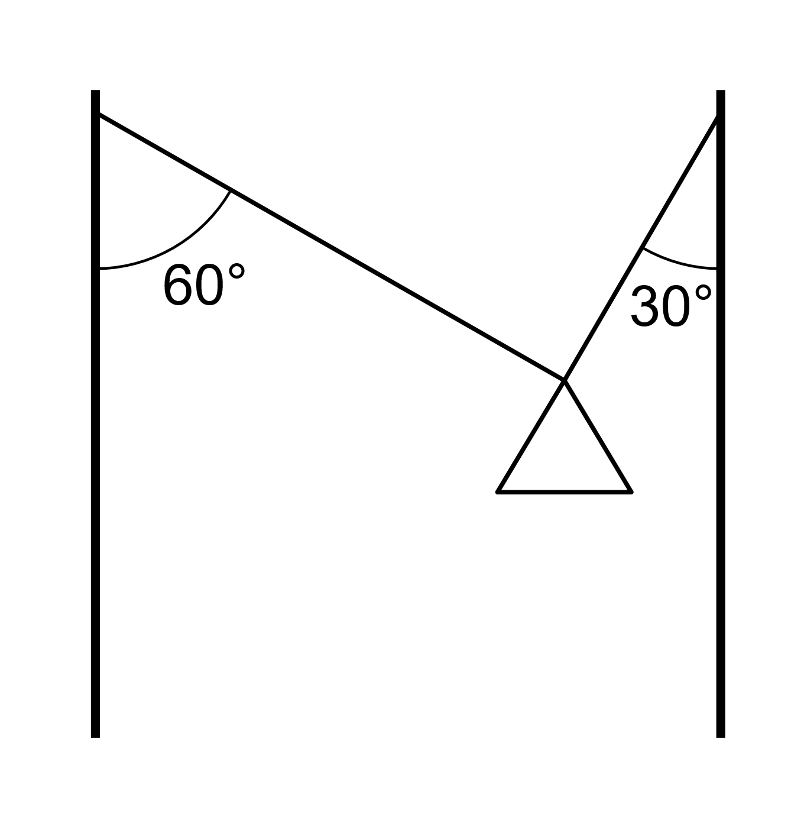
Review #1
A street lamp weighing 50 kg hangs from two poles as shown below. Calculate the magnitude of the tension in each wire.

Slide 2
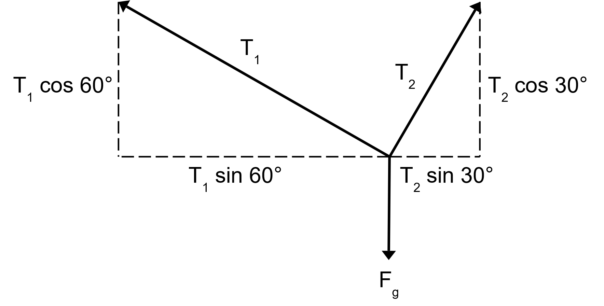

Review #1
A street lamp weighing 50 kg hangs from two poles as shown below. Calculate the tension in each wire.
Resolve force vectors:
The lamp is not moving, so horizontal forces must be balanced:
$$T_{1}\sin{60°}=T_{2}\sin{30°}$$
$$T_{1}=\frac{T_{2}\sin{30°}}{\sin{60°}}$$

Slide 3
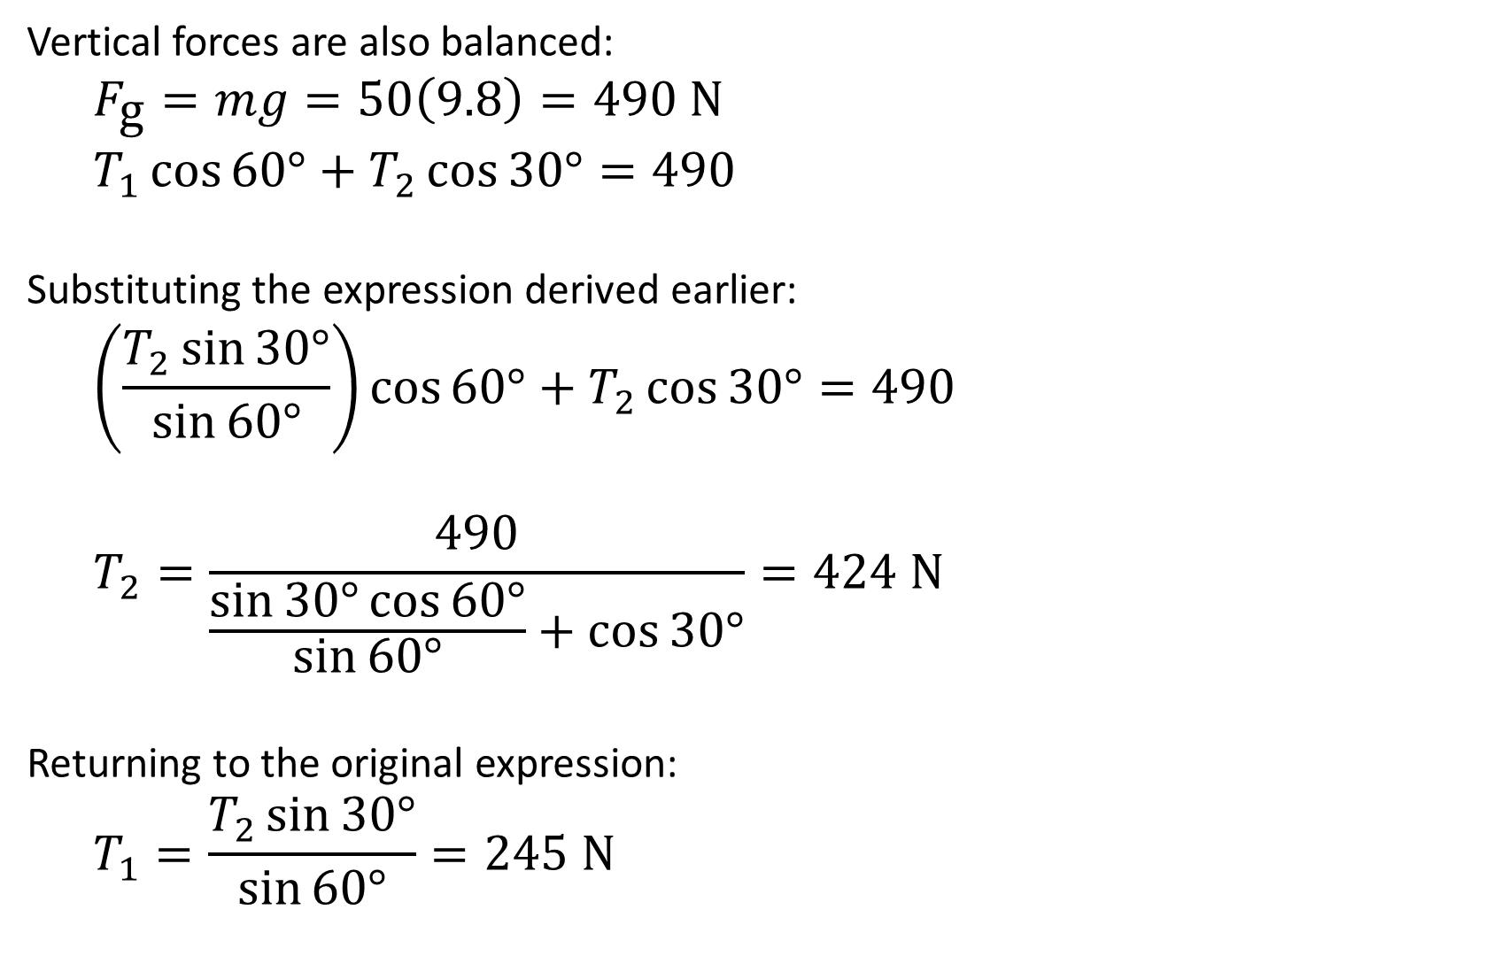
Review #1
Vertical forces are also balanced:
$$F_{\text{g}}=mg=50\left(9.8\right)=490 \text{N}$$
$$T_{1}\cos{60°}+T_{2}\cos{30°}=490$$
Substituting the expression derived earlier:
$$\left(\frac{T_{2}\sin{30°}}{\sin{60°}}\right)\cos{60°}+T_{2}\cos{30°}=490$$
$$T_{2}=\frac{490}{\frac{\sin{30°}\cos{60°}}{\sin{60°}}+\cos{30°}}=424 \text{N}$$
Returning to the original expression:
$$T_{1}=\frac{T_{2}\sin{30°}}{\sin{60°}}=245 \text{N}$$

Slide 4
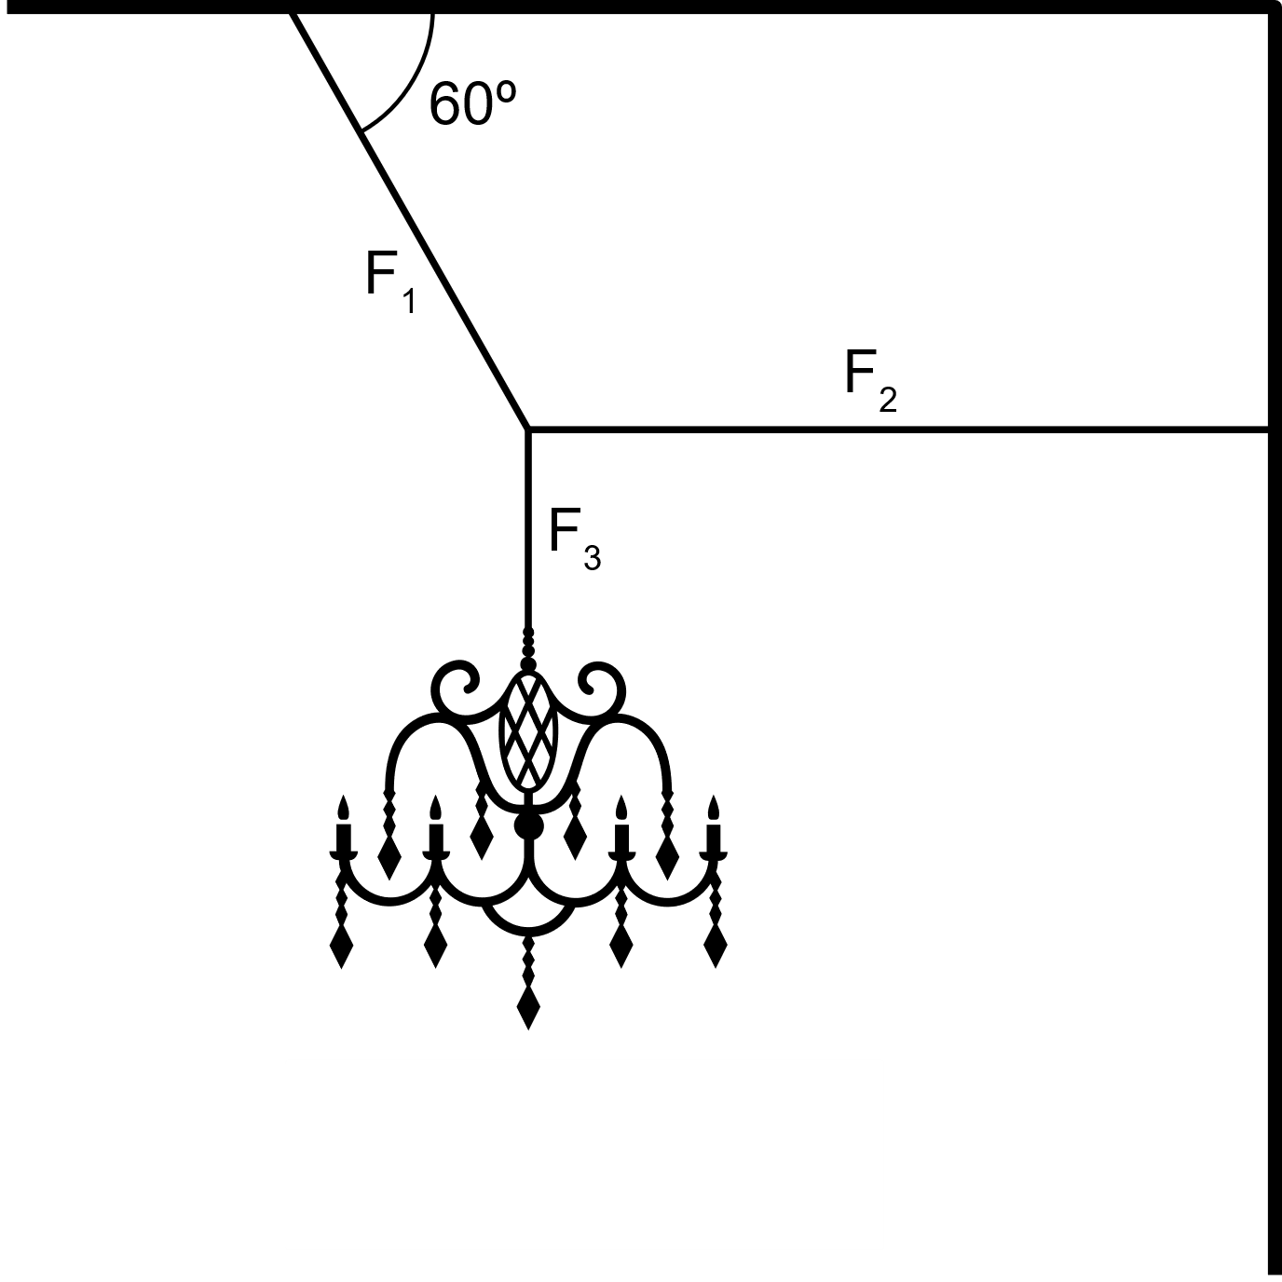
Review #2
A chandelier is hanging from a ceiling as shown. The mass of the chandelier is 200 kg. Find the forces F₁, F₂, and F₃.

Slide 5
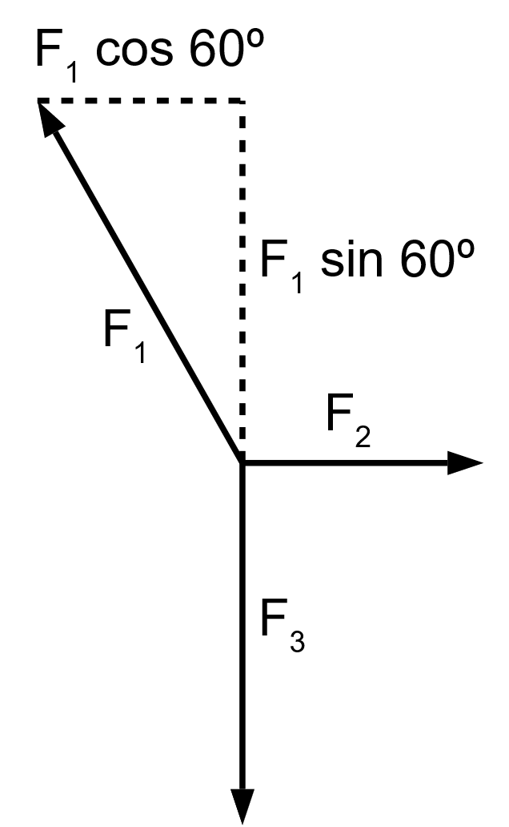
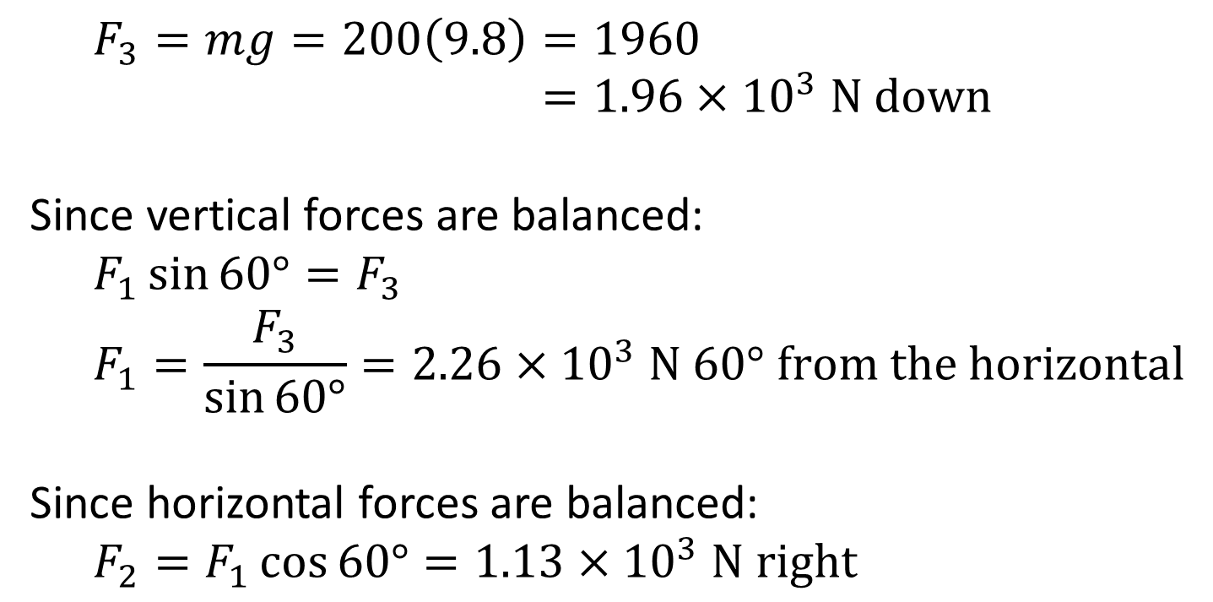
Review #2
$$F_{3}=mg=200\left(9.8\right)=1960 \\ =1.96×{10}^{3} \text{N} \text{down}$$
Since vertical forces are balanced:
$$F_{1}\sin{60°}=F_{3}$$
$$F_{1}=\frac{F_{3}}{\sin{60°}}=2.26×{10}^{3} \text{N}\text{ 60}\text{°} \text{from} \text{the} \text{horizontal}$$
Since horizontal forces are balanced:
$$F_{2}=F_{1}\cos{60°}=1.13×{10}^{3} \text{N} \text{right}$$

Slide 6
Equilibrium

Slide 7
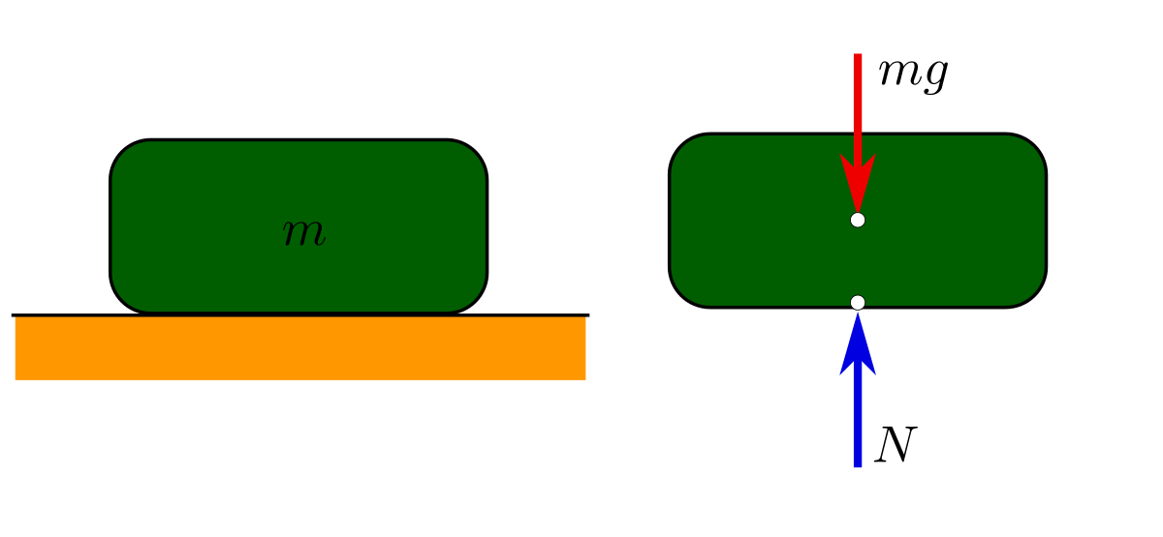
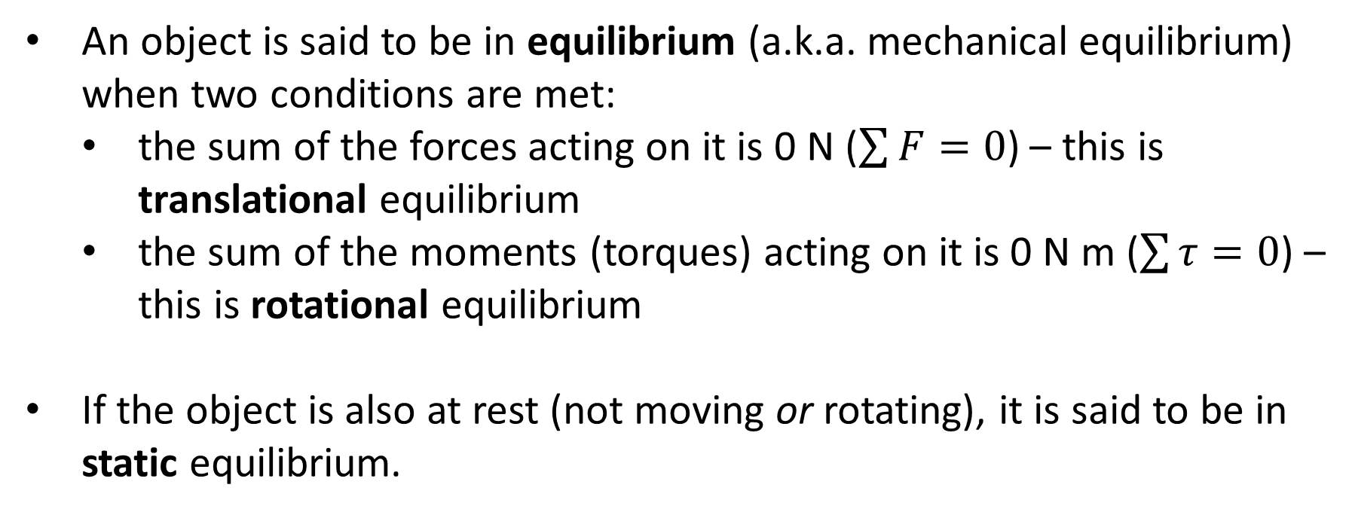
Equilibrium
An object is said to be in equilibrium (a.k.a. mechanical equilibrium) when two conditions are met:
the sum of the forces acting on it is 0 N ($\sum{F}=0$) – this is translational equilibrium
the sum of the moments (torques) acting on it is 0 N m ($\sum{τ}=0$) – this is rotational equilibrium
If the object is also at rest (not moving or rotating), it is said to be in static equilibrium.

Slide 8
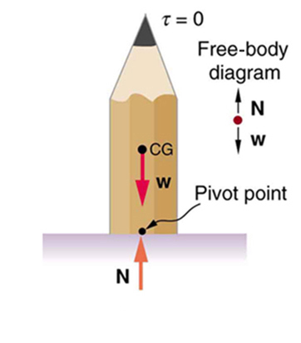
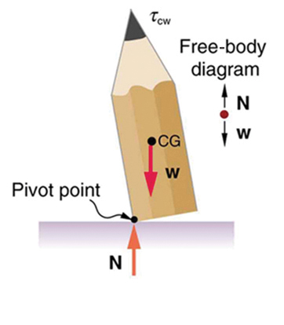
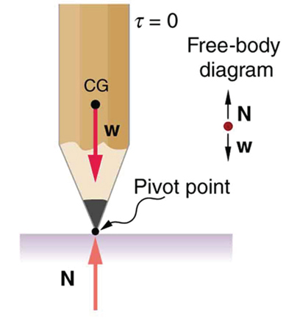
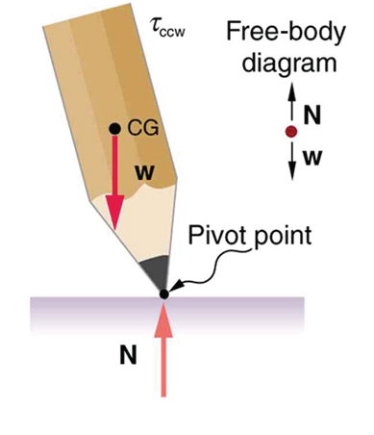
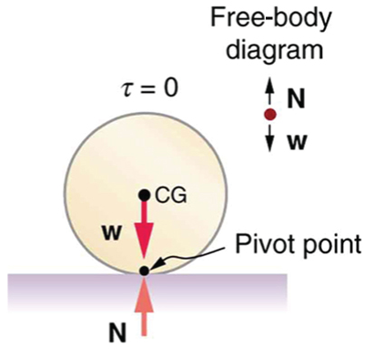
Stability
States of equilibrium can be further classified as follows:
Stable equilibrium: if the object is displaced, it experiences a net force or torque in the opposite direction to the displacing force. This is known as a restoring force / torque.
Centre of mass is raised, then returns
Unstable equilibrium: if the object is displaced, it experiences a net force or torque in the same direction as the displacing force.
Centre of mass is lowered, and continues
Neutral equilibrium: if the object is displaced, its equilibrium is unaffected.
Height of centre of mass is unchanged
Notes:
Note that objects in rightmost diagrams are not in equilibrium (Στ ≠ 0)

Slide 9
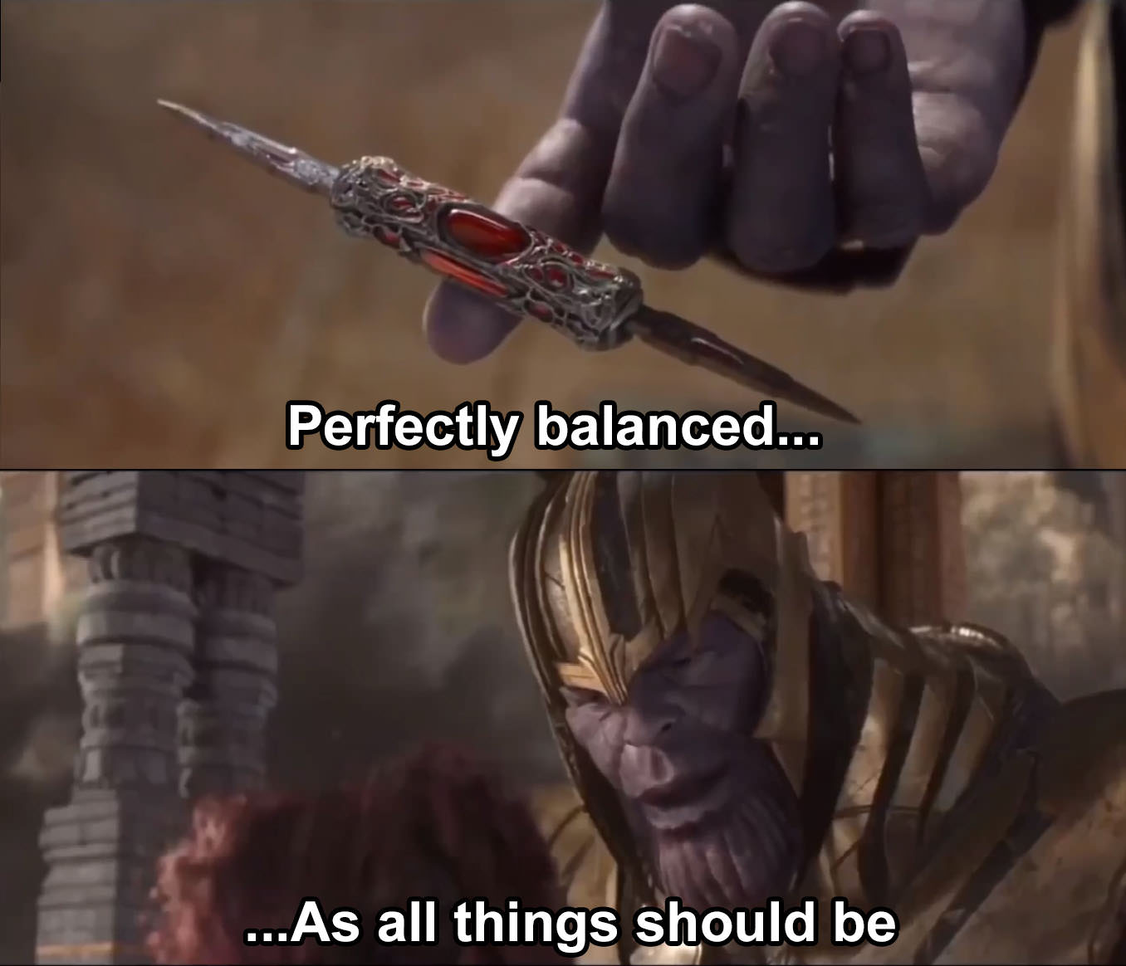
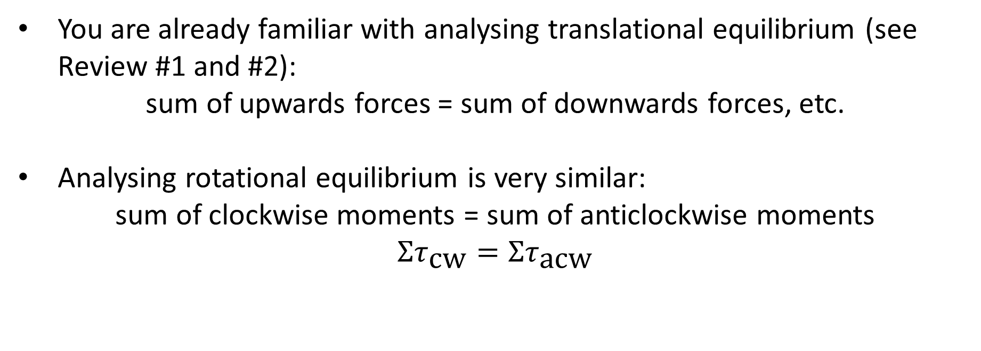
Analysing Equilibrium
You are already familiar with analysing translational equilibrium (see Review #1 and #2):
sum of upwards forces = sum of downwards forces, etc.
Analysing rotational equilibrium is very similar:
sum of clockwise moments = sum of anticlockwise moments
$$Στ_{\text{cw}}=Στ_{\text{acw}}$$

Slide 10
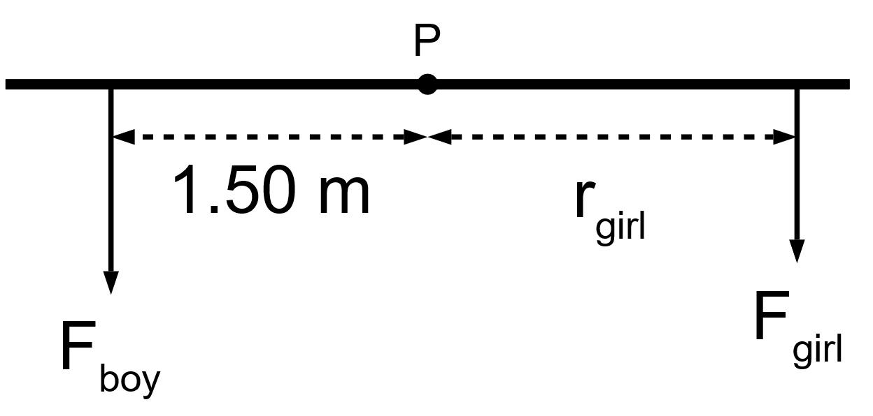
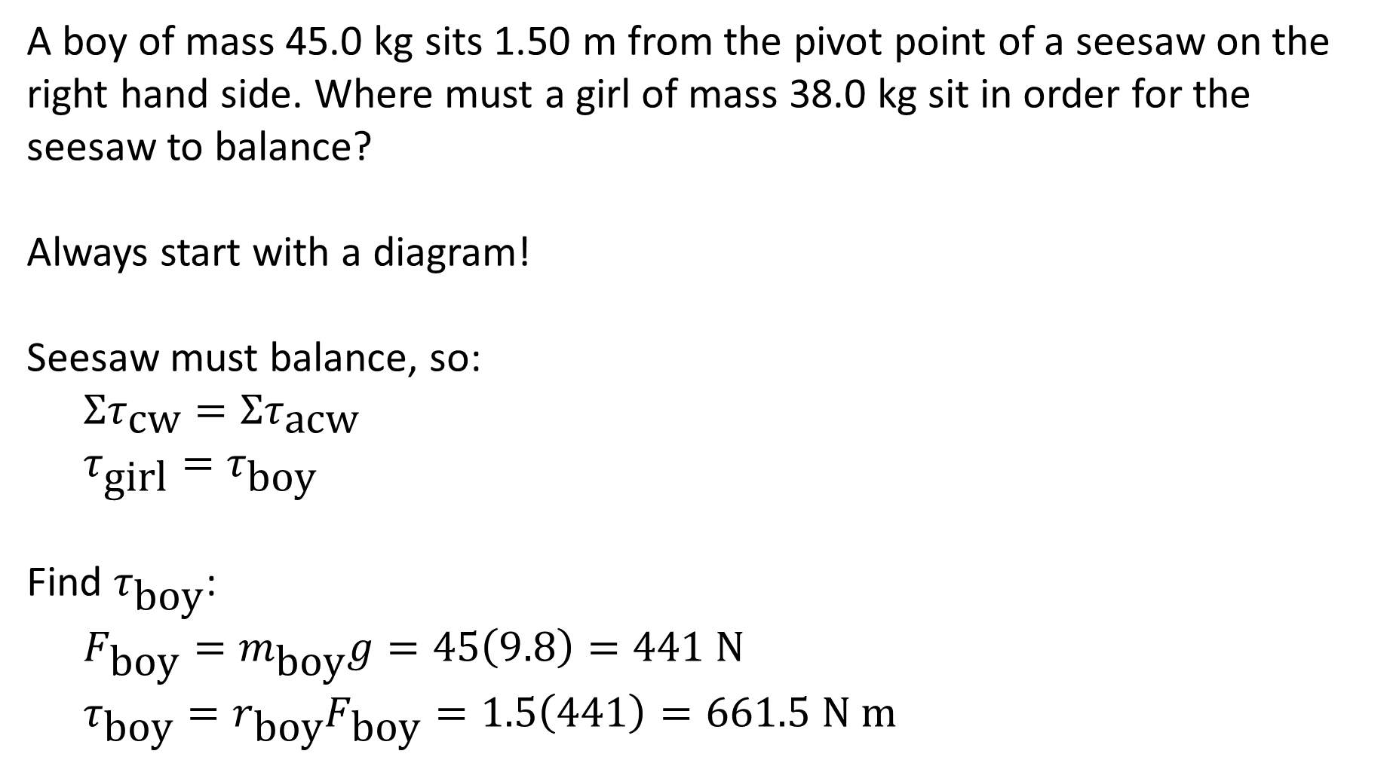
Example #1
A boy of mass 45.0 kg sits 1.50 m from the pivot point of a seesaw on the right hand side. Where must a girl of mass 38.0 kg sit in order for the seesaw to balance?
Always start with a diagram!
Seesaw must balance, so:
$$Στ_{\text{cw}}=Στ_{\text{acw}}$$
$$τ_{\text{girl}}=τ_{\text{boy}}$$
Find $τ_{\text{boy}}$:
$$F_{\text{boy}}=m_{\text{boy}}g=45\left(9.8\right)=441 \text{N}$$
$$τ_{\text{boy}}=r_{\text{boy}}F_{\text{boy}}=1.5\left(441\right)=661.5 \text{N} \text{m}$$

Slide 11
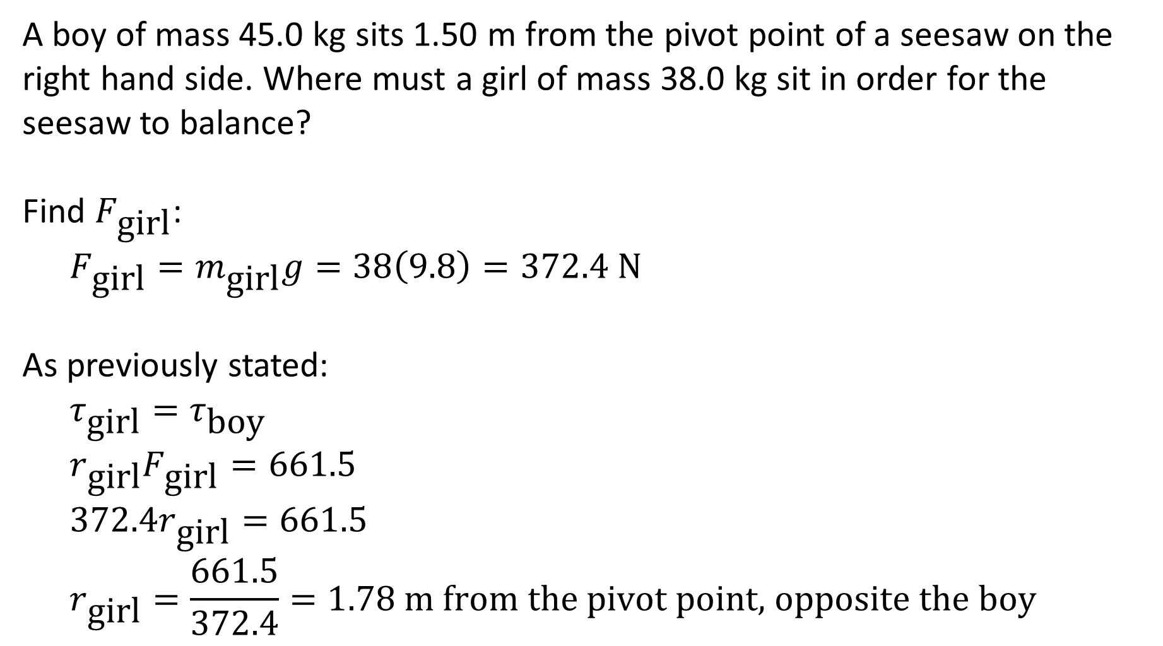
Example #1
A boy of mass 45.0 kg sits 1.50 m from the pivot point of a seesaw on the right hand side. Where must a girl of mass 38.0 kg sit in order for the seesaw to balance?
Find $F_{\text{girl}}$:
$$F_{\text{girl}}=m_{\text{girl}}g=38\left(9.8\right)=372.4 \text{N}$$
As previously stated:
$$τ_{\text{girl}}=τ_{\text{boy}}$$
$$r_{\text{girl}}F_{\text{girl}}=661.5$$
$$372.4r_{\text{girl}}=661.5$$
$$r_{\text{girl}}=\frac{661.5}{372.4}=1.78 \text{m} \text{from} \text{the} \text{pivot} \text{point}\text{, }\text{opposite} \text{the} \text{boy}$$

Slide 12
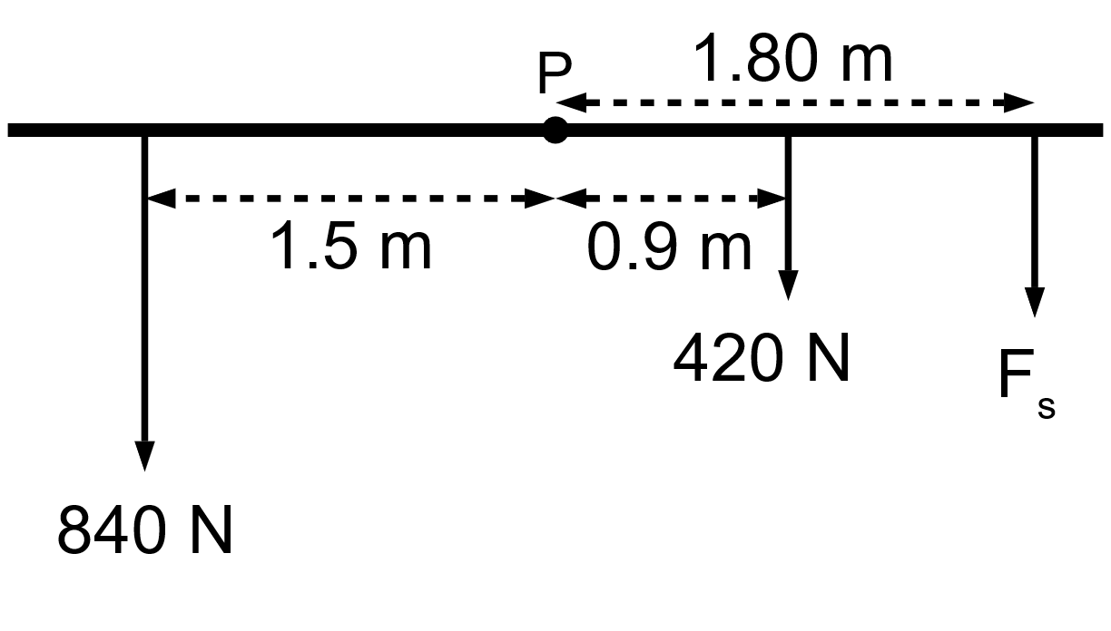
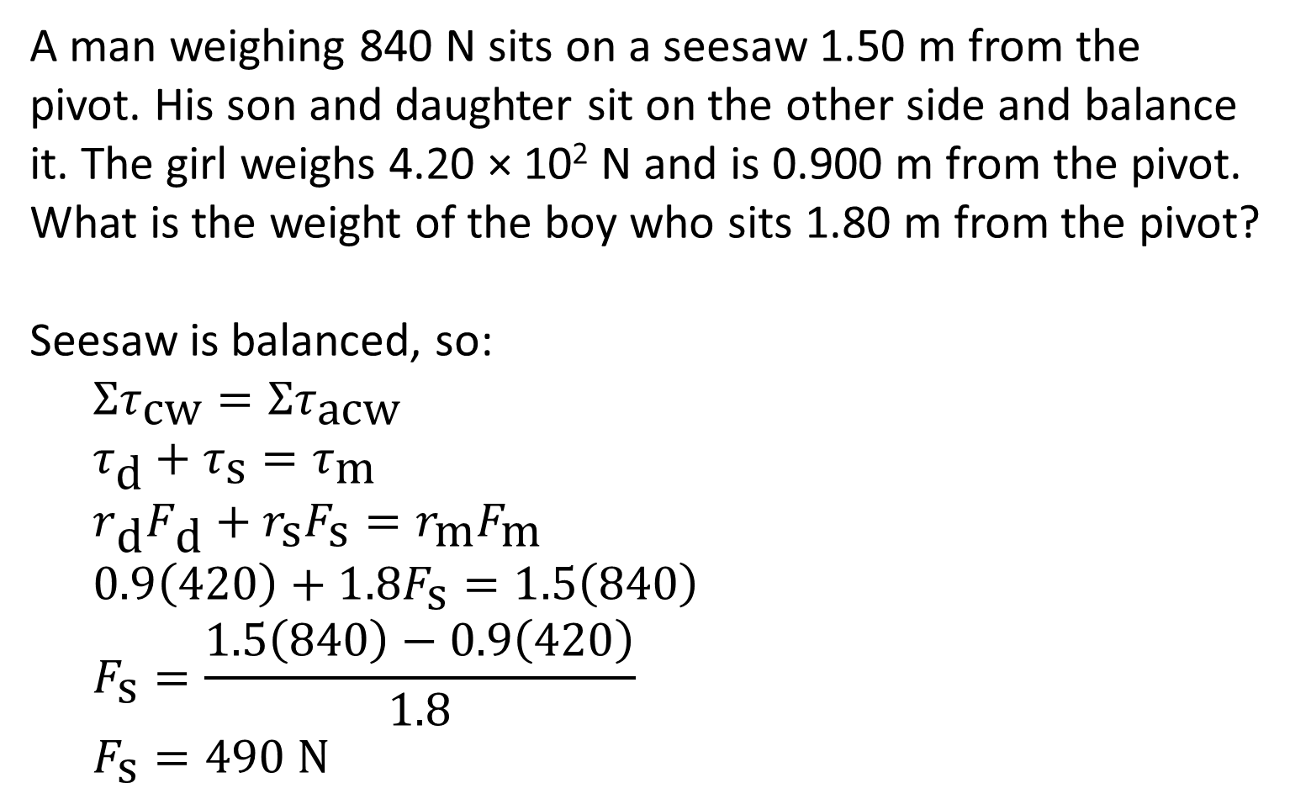
Example #2
A man weighing 840 N sits on a seesaw 1.50 m from the pivot. His son and daughter sit on the other side and balance it. The girl weighs 4.20 × 10² N and is 0.900 m from the pivot. What is the weight of the boy who sits 1.80 m from the pivot?
Seesaw is balanced, so:
$$Στ_{\text{cw}}=Στ_{\text{acw}}$$
$$τ_{\text{d}}+τ_{\text{s}}=τ_{\text{m}}$$
$$r_{\text{d}}F_{\text{d}}+r_{\text{s}}F_{\text{s}}=r_{\text{m}}F_{\text{m}}$$
$$0.9\left(420\right)+1.8F_{\text{s}}=1.5\left(840\right)$$
$$F_{\text{s}}=\frac{1.5\left(840\right)−0.9\left(420\right)}{1.8}$$
$$F_{\text{s}}=490 \text{N}$$

Slide 13
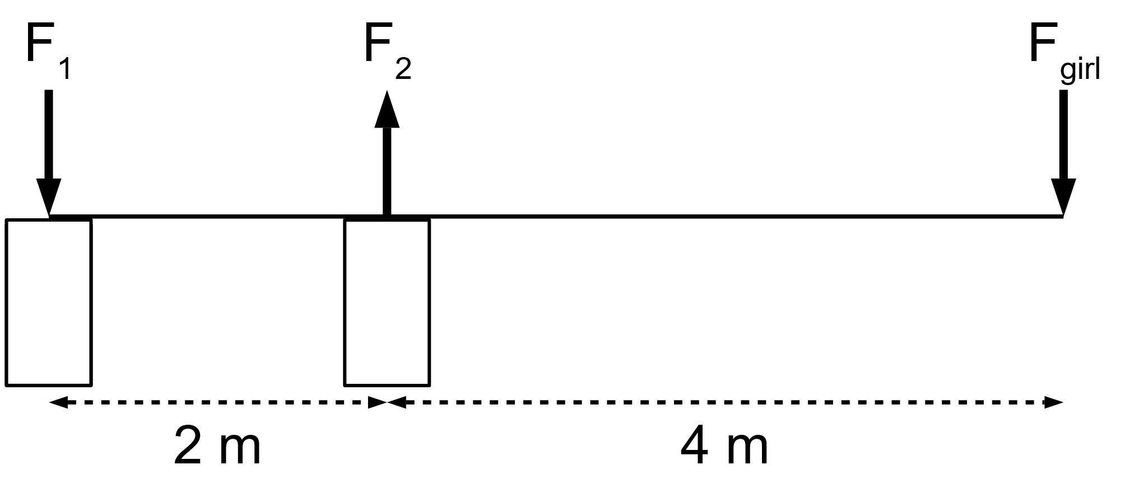
Example #3
What are the forces F₁ and F₂ that the supports exert on the 25.0 kg diving board shown in the diagram below when a 45.0 kg girl stands at its end?

Slide 14
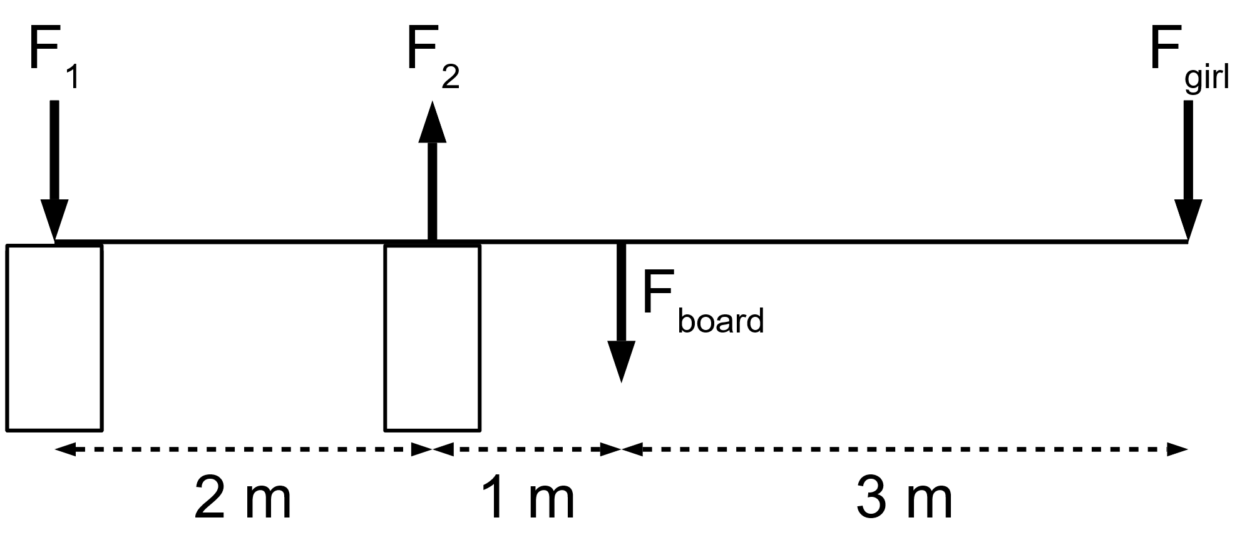
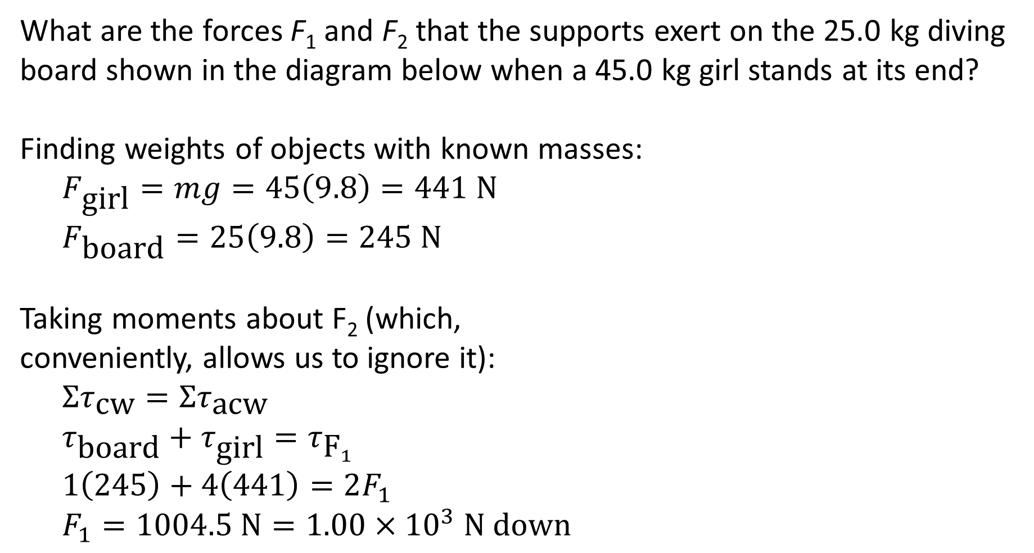
Example #3
What are the forces F₁ and F₂ that the supports exert on the 25.0 kg diving board shown in the diagram below when a 45.0 kg girl stands at its end?
Finding weights of objects with known masses:
$$F_{\text{girl}}=mg=45\left(9.8\right)=441 \text{N}$$
$$F_{\text{board}}=25\left(9.8\right)=245 \text{N}$$
Taking moments about F₂ (which, conveniently, allows us to ignore it):
$$Στ_{\text{cw}}=Στ_{\text{acw}}$$
$$τ_{\text{board}}+τ_{\text{girl}}=τ_{{\text{F}}_{1}}$$
$$1\left(245\right)+4\left(441\right)=2F_{1}$$
$$F_{1}=1004.5 \text{N}=1.00×{10}^{3} \text{N} \text{down}$$

Slide 15
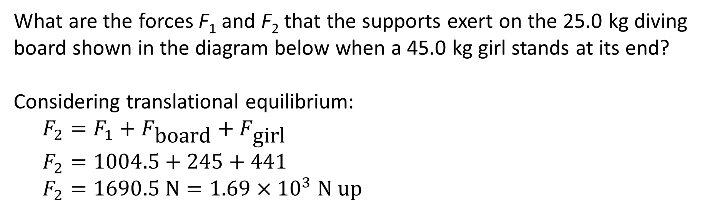
Example #3
What are the forces F₁ and F₂ that the supports exert on the 25.0 kg diving board shown in the diagram below when a 45.0 kg girl stands at its end?
Considering translational equilibrium:
$$F_{2}=F_{1}+F_{\text{board}}+F_{\text{girl}}$$
$$F_{2}=1004.5+245+441$$
$$F_{2}=1690.5 \text{N}=1.69×{10}^{3} \text{N} \text{up}$$

Slide 16
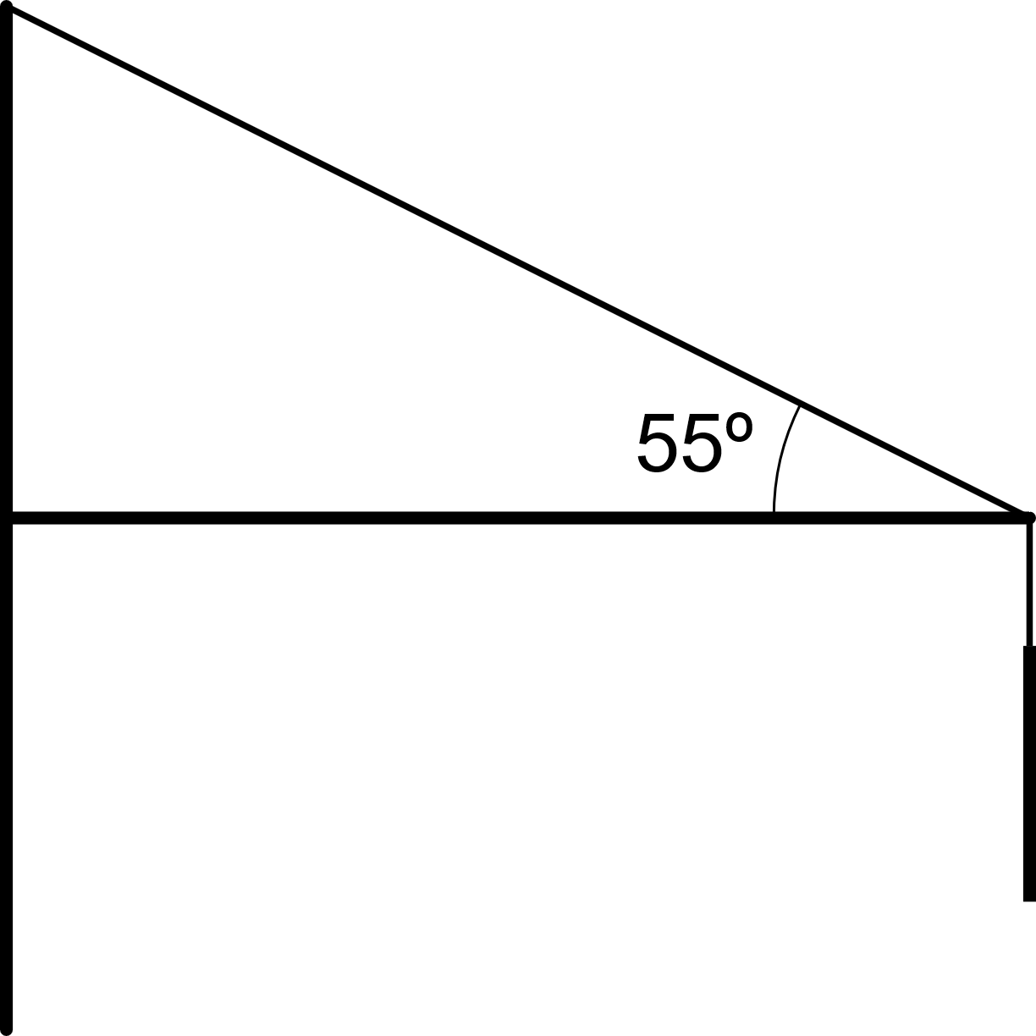
Example #4
The diagram below shows a sign handing in front of a shop. If the sign weighs 2.40 × 10² N and the angle the rope makes with the bar is 55°, how much tension is in the rope? The bar has a mass of 5.00 kg and is 0.800 m long.

Slide 17
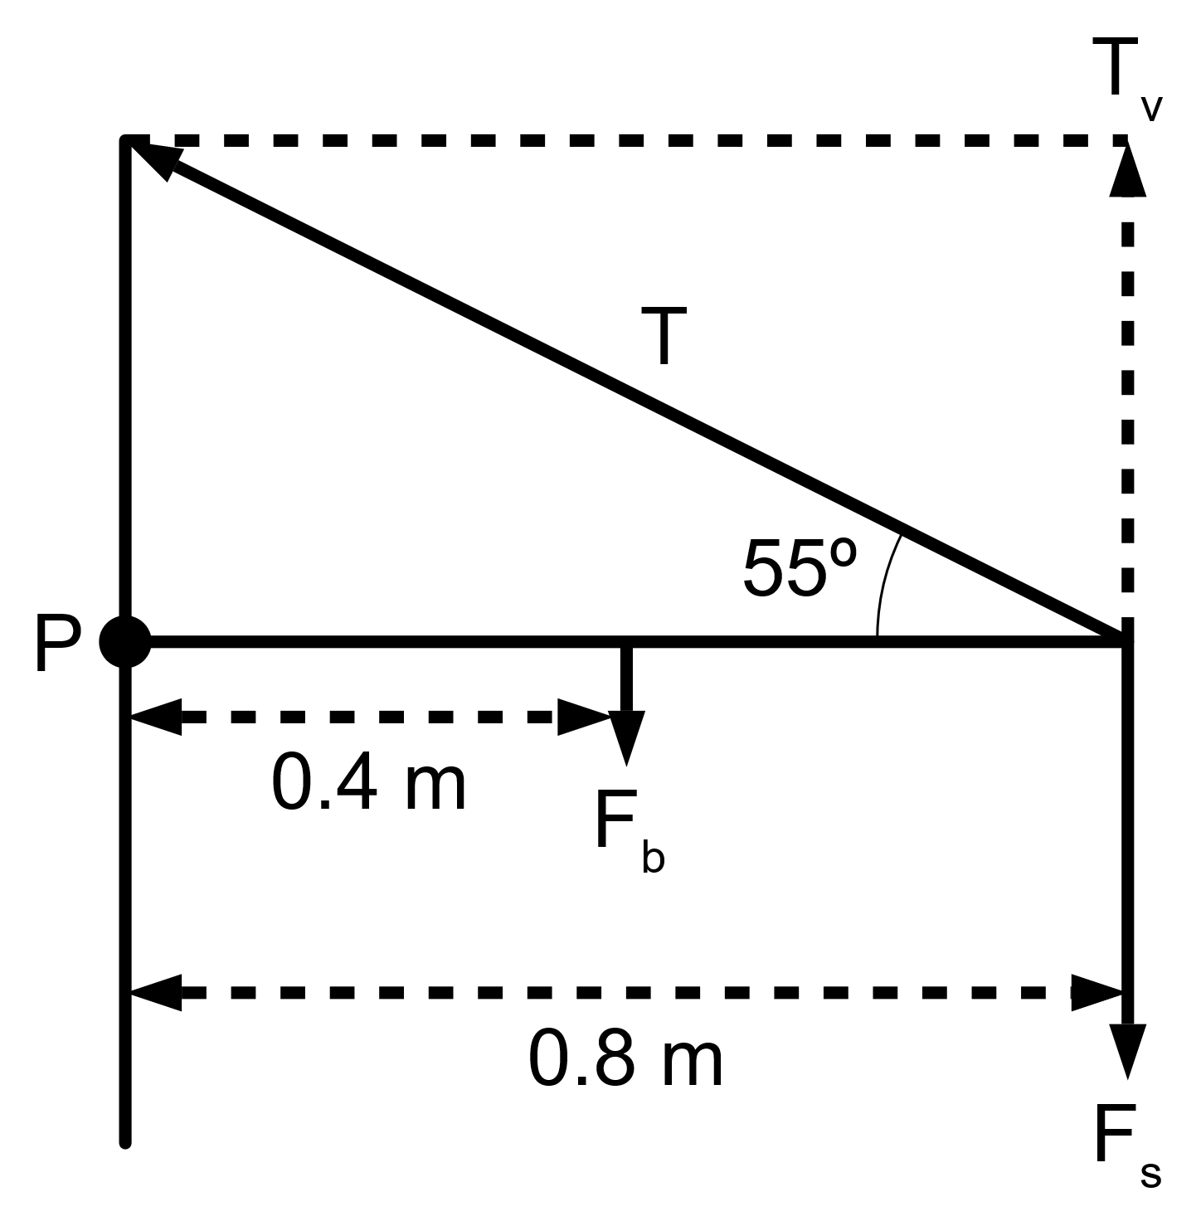
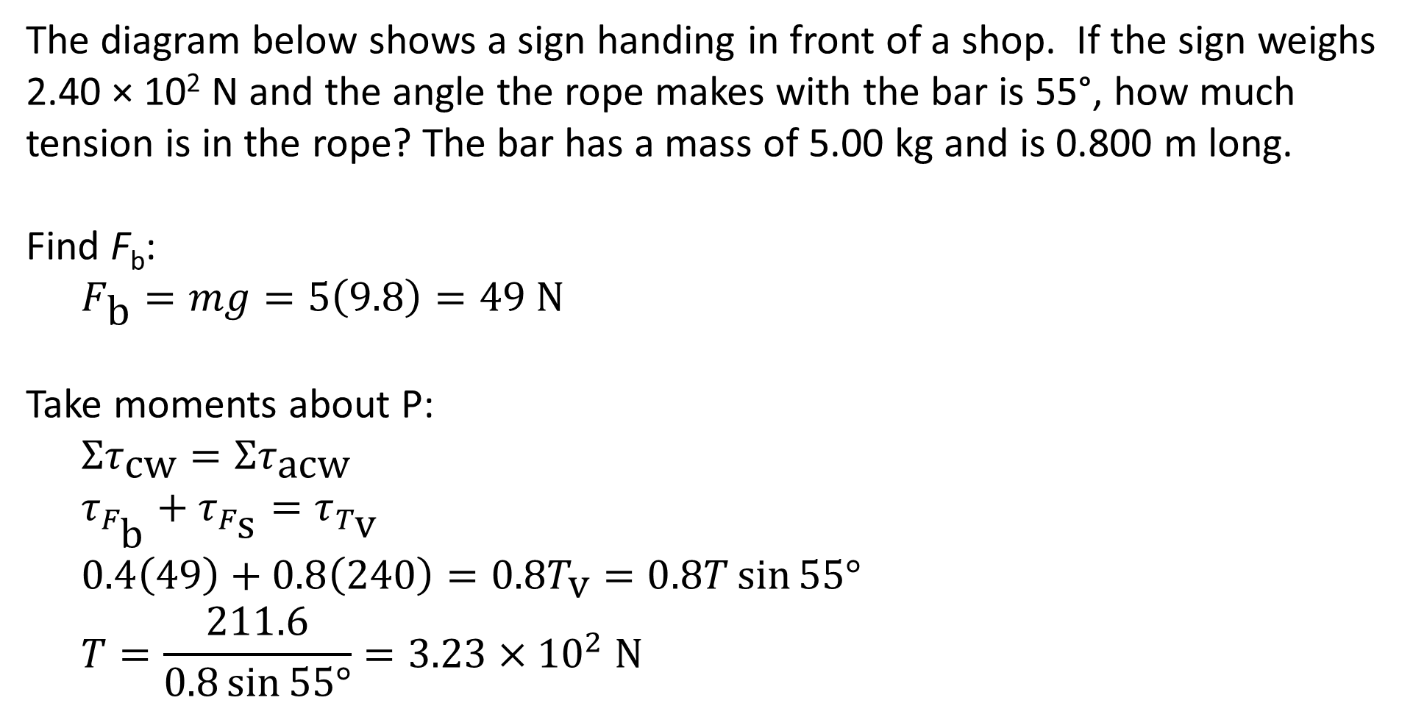
Example #4
The diagram below shows a sign handing in front of a shop. If the sign weighs 2.40 × 10² N and the angle the rope makes with the bar is 55°, how much tension is in the rope? The bar has a mass of 5.00 kg and is 0.800 m long.
Find F_{b}:
$$F_{\text{b}}=mg=5\left(9.8\right)=49 \text{N}$$
Take moments about P:
$$Στ_{\text{cw}}=Στ_{\text{acw}}$$
$$τ_{F_{\text{b}}}+τ_{F_{\text{s}}}=τ_{T_{\text{v}}}$$
$$0.4\left(49\right)+0.8\left(240\right)=0.8T_{\text{v}}=0.8T\sin{55°}$$
$$T=\frac{211.6}{0.8\sin{55°}}=3.23×{10}^{2} \text{N}$$

Slide 18
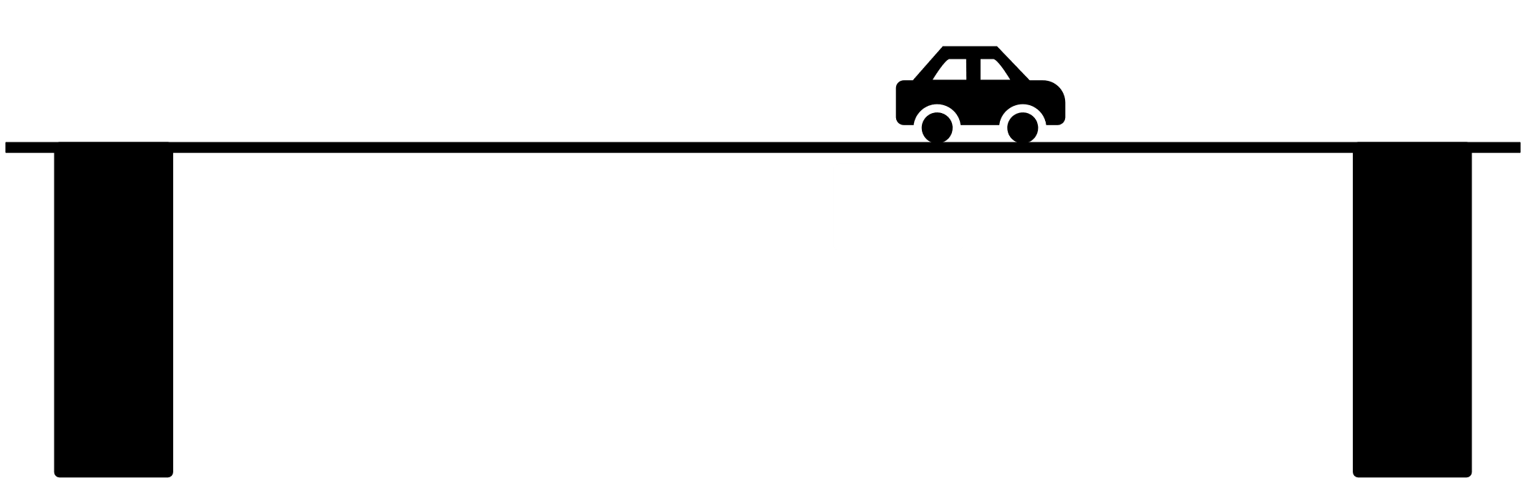
Example #5
A long bridge of mass 1.00 × 10⁴ kg is supported by two large columns as shown. The columns’ centres of mass are 24.0 m apart. If a 9.00 × 10² kg car is two-thirds of the way across the bridge, what is the force each column is providing?

Slide 19
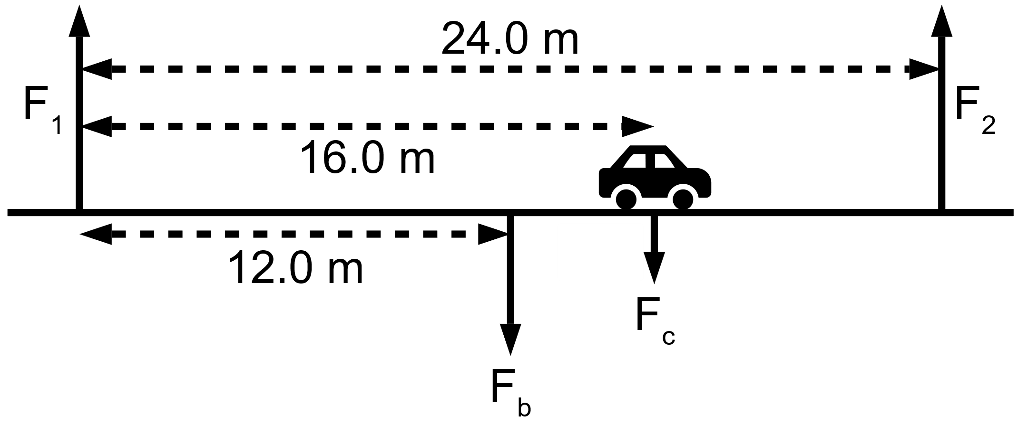
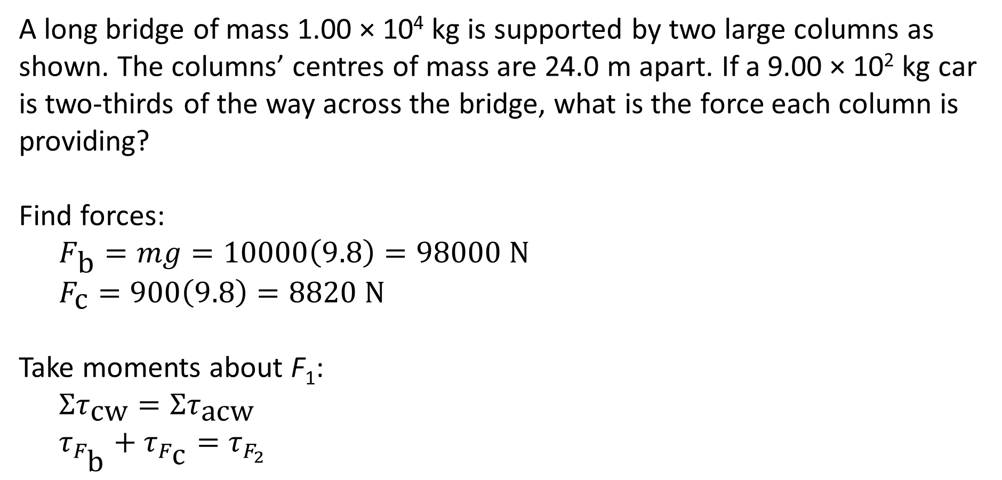
Example #5
A long bridge of mass 1.00 × 10⁴ kg is supported by two large columns as shown. The columns’ centres of mass are 24.0 m apart. If a 9.00 × 10² kg car is two-thirds of the way across the bridge, what is the force each column is providing?
Find forces:
$$F_{\text{b}}=mg=10000\left(9.8\right)=98000 \text{N}$$
$$F_{\text{c}}=900\left(9.8\right)=8820 \text{N}$$
Take moments about F₁:
$$Στ_{\text{cw}}=Στ_{\text{acw}}$$
$$τ_{F_{\text{b}}}+τ_{F_{\text{c}}}=τ_{F_{2}}$$

Slide 20
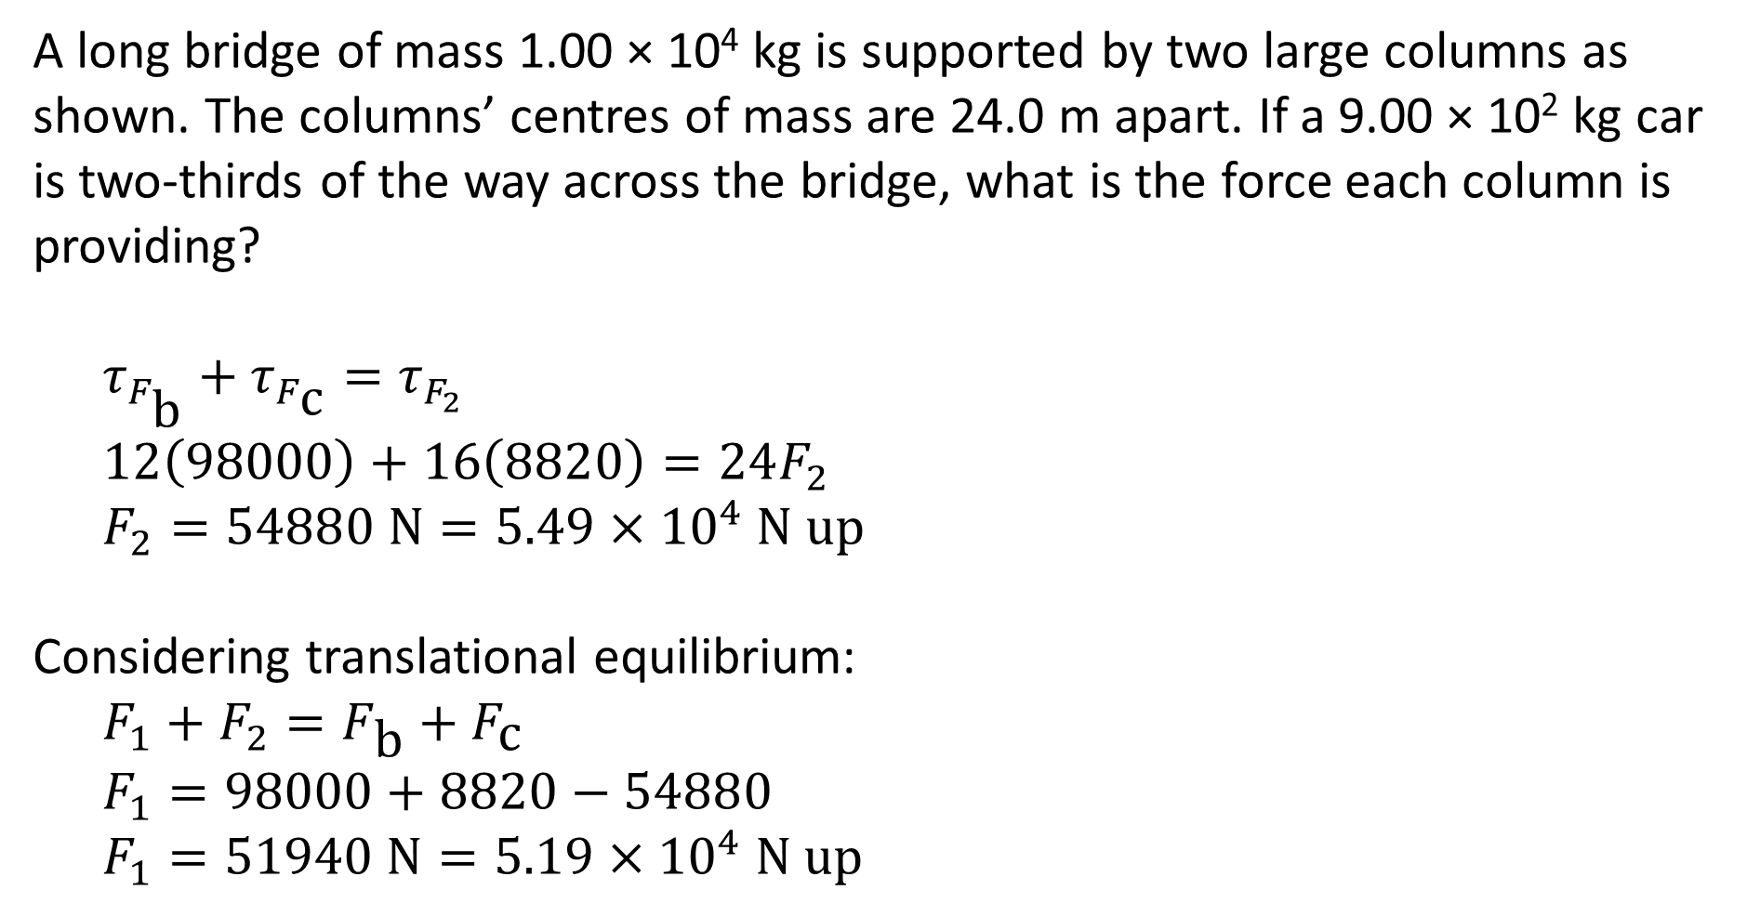
Example #5
A long bridge of mass 1.00 × 10⁴ kg is supported by two large columns as shown. The columns’ centres of mass are 24.0 m apart. If a 9.00 × 10² kg car is two-thirds of the way across the bridge, what is the force each column is providing?
$$τ_{F_{\text{b}}}+τ_{F_{\text{c}}}=τ_{F_{2}}$$
$$12\left(98000\right)+16\left(8820\right)=24F_{2}$$
$$F_{2}=54880 \text{N}=5.49×{10}^{4} \text{N} \text{up}$$
Considering translational equilibrium:
$$F_{1}+F_{2}=F_{\text{b}}+F_{\text{c}}$$
$$F_{1}=98000+8820−54880$$
$$F_{1}=51940 \text{N}=5.19×{10}^{4} \text{N} \text{up}$$

Slide 21
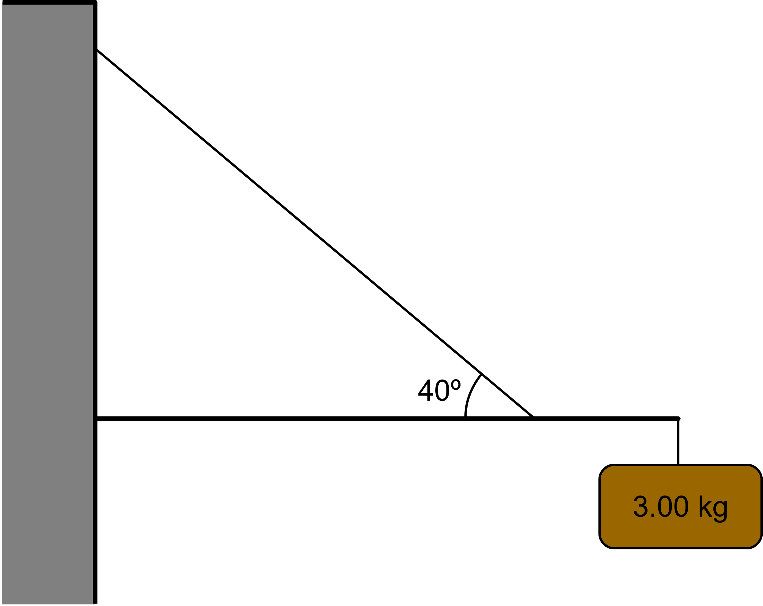
Example #6
The diagram below shows a bracket used to hang a 3.00 kg sign from a wall. The horizontal beam is 1.00 m long and has a mass of 1.50 kg. The wire is attached 0.750 m along the beam. Find:
The tension in the wire cable
The compression in the beam
The reaction force that the wall applies to the beam

Slide 22
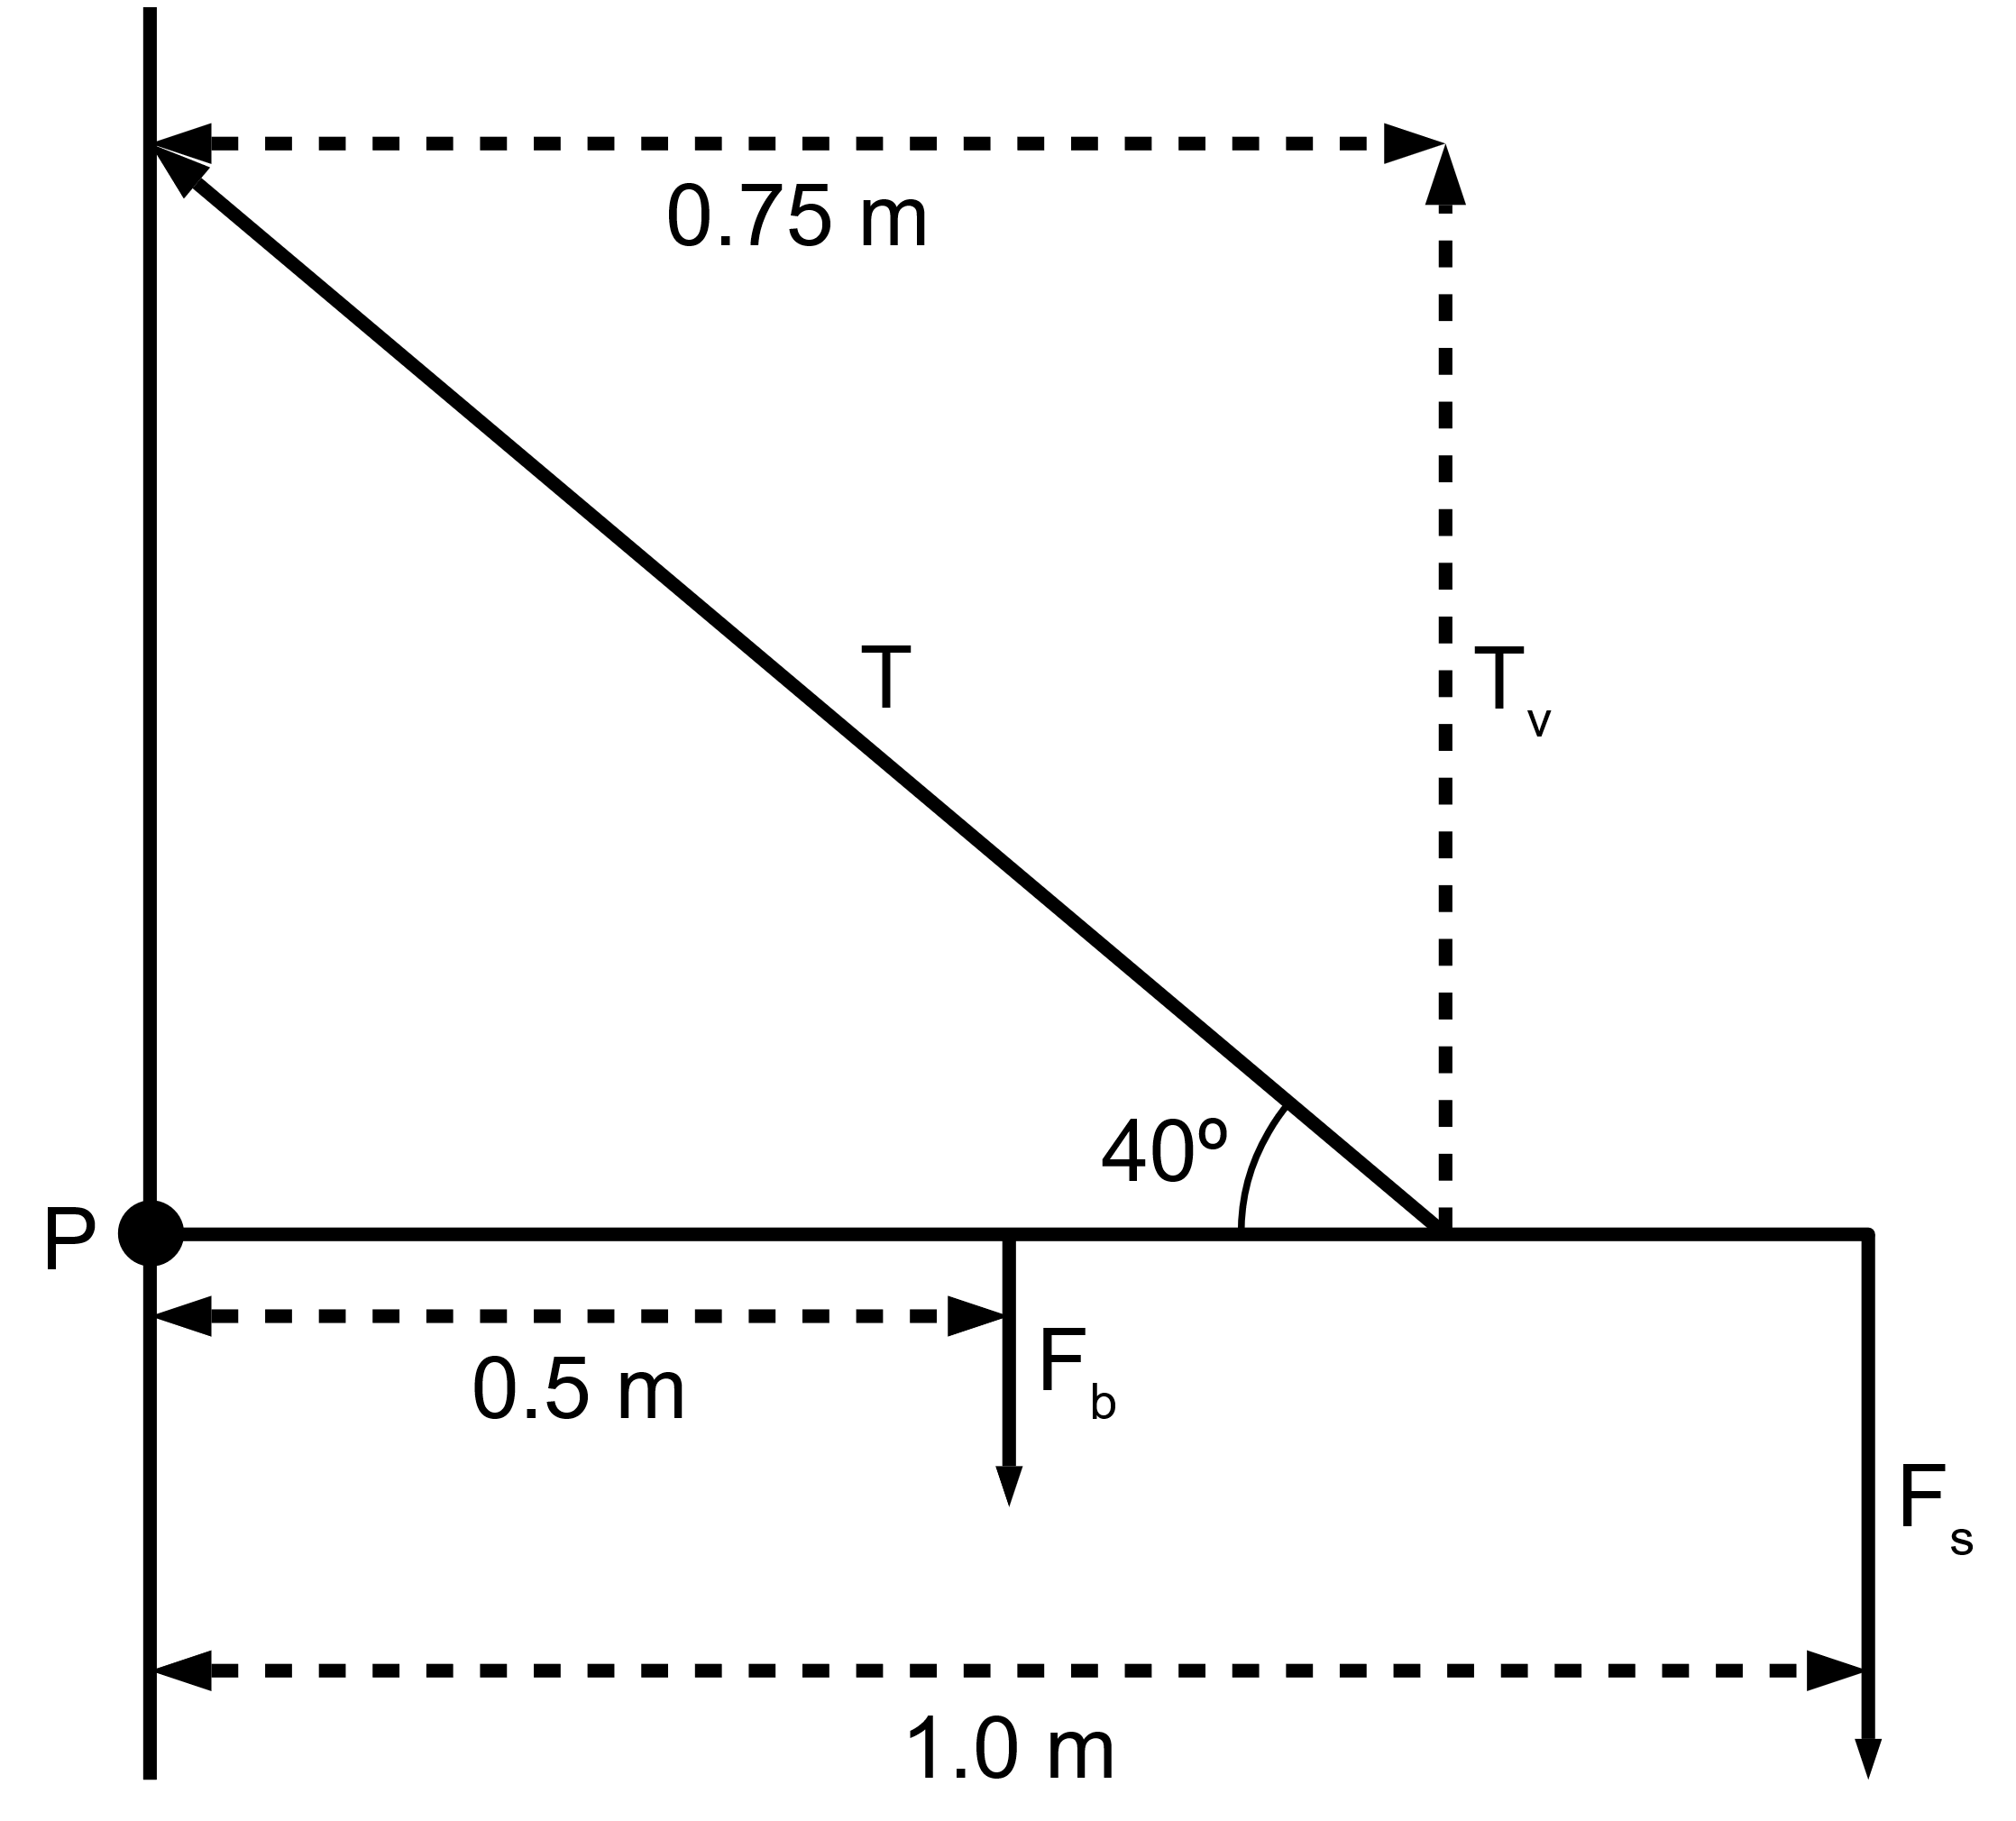

Example #6
The diagram below shows a bracket used to hang a 3.00 kg sign from a wall. The horizontal beam is 1.00 m long and has a mass of 1.50 kg. The wire is attached 0.750 m along the beam. Find:
The tension in the wire cable
Find forces:
$$F_{\text{b}}=mg=1.5\left(9.8\right)=14.7 \text{N}$$
$$F_{\text{s}}=3\left(9.8\right)=29.4 \text{N}$$
Take moments about P:
$$Στ_{\text{cw}}=Στ_{\text{acw}}$$
$$τ_{F_{\text{b}}}+τ_{F_{\text{s}}}=τ_{T_{\text{v}}}$$
$$0.5\left(14.7\right)+1.0\left(29.4\right)=0.75T_{\text{v}}$$
$$T_{\text{v}}=49 \text{N}$$

Slide 23

Example #6
The diagram below shows a bracket used to hang a 3.00 kg sign from a wall. The horizontal beam is 1.00 m long and has a mass of 1.50 kg. The wire is attached 0.750 m along the beam. Find:
The tension in the wire cable
$$T_{\text{v}}=49 \text{N}=T\sin{40°}$$
$$T=76.2 \text{N}\text{ 40}\text{°} \text{from} \text{the} \text{horizontal}$$
The compression in the beam
This is the horizontal force on the beam, T_{h}:
$$T_{\text{h}}=T\cos{40°}$$
$$T_{\text{h}}=58.4 \text{N} \text{to} \text{the} \text{left}$$

Slide 24
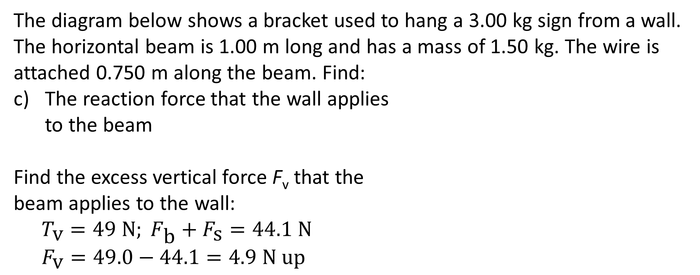
Example #6
The diagram below shows a bracket used to hang a 3.00 kg sign from a wall. The horizontal beam is 1.00 m long and has a mass of 1.50 kg. The wire is attached 0.750 m along the beam. Find:
The reaction force that the wall applies to the beam
Find the excess vertical force F_{v} that the beam applies to the wall:
$$T_{\text{v}}=49 \text{N}; F_{\text{b}}+F_{\text{s}}=44.1 \text{N}$$
$$F_{\text{v}}=49.0−44.1=4.9 \text{N} \text{up}$$

Slide 25
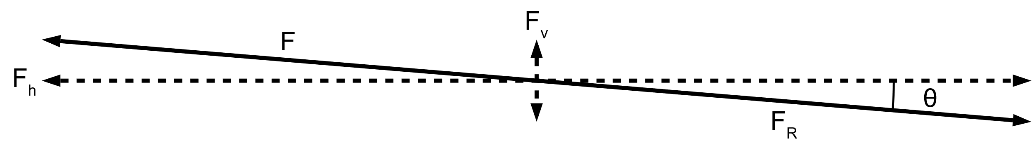
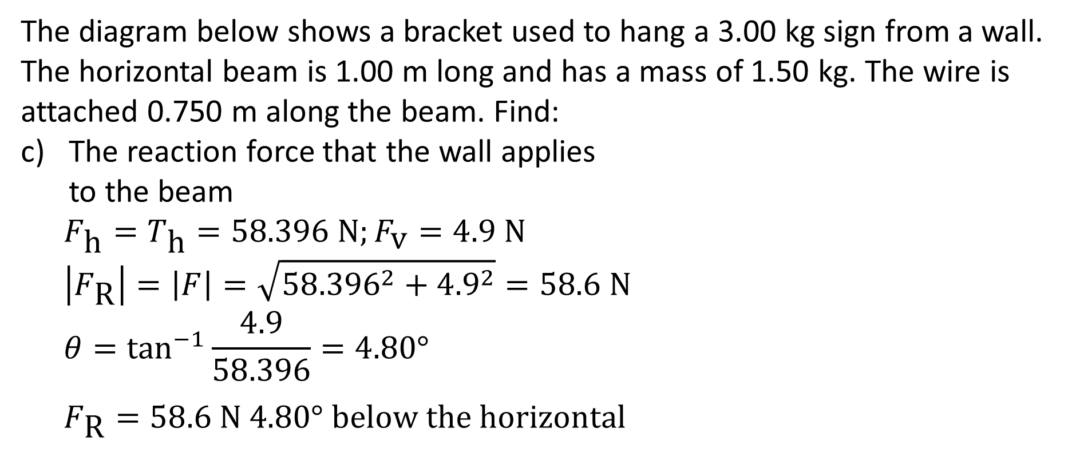
Example #6
The diagram below shows a bracket used to hang a 3.00 kg sign from a wall. The horizontal beam is 1.00 m long and has a mass of 1.50 kg. The wire is attached 0.750 m along the beam. Find:
The reaction force that the wall applies to the beam
$$F_{\text{h}}=T_{\text{h}}=58.396 \text{N};F_{\text{v}}=4.9 \text{N}$$
$$\left|F_{\text{R}}\right|=\left|F\right|=\sqrt{{58.396}^{2}+{4.9}^{2}}=58.6 \text{N}$$
$$θ=\tan^{−1}{\frac{4.9}{58.396}}=4.80°$$
$$F_{\text{R}}=58.6 \text{N} 4.80° \text{below} \text{the} \text{horizontal}$$

